Slide 1
Fundamentals of Information Technology UNIT - IV

Slide 2
Learning Objectives
In this Unit we will discuss :
Basic elements of a Communication System
Data transmission media
Digital and Analog Transmission
Network topologies
Network Types (LAN, WAN and MAN)
Introduction to Communication protocols
Inter networking tools

Slide 3
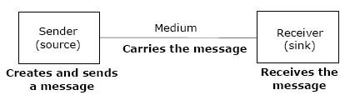
Basic Elements

Slide 4
Transmission Modes
Transmission Modes

Slide 5
Transmission Speed
§ Bandwidth: Range of frequencies available for data
transmission. It refers to data transmission rate. Higher
the bandwidth, the more data it can transmit
§ Baud: Unit of measurement of data transfer rate.
Measured in bits per second (bps)

Slide 6
Transmission Speed
§ Narrowband: Sub-voice grade channels in range from
45 to 300 baud. Mainly used for telegraph lines and
low-speed terminals
§ Voiceband: Voice grade channels with speed up to
9600 baud. Mainly used for ordinary telephone voice
communication and slow I/O devices
§ Broadband: High speed channels with speed up to 1
million baud or more. Mainly used for high-speed
computer-to-computer communication or for
simultaneous transmission of data

Slide 7
Transmission Media
The most commonly used ones are:
§ Twisted-pair wire (UTP cable)
§ Coaxial cable
§ Microwave system
§ Communications satellite
§ Optical fibers

Slide 8
Twisted Pair
A type of cable that consists of two independently insulated wires twisted around one another. The use of two wires twisted together helps to reduce crosstalk and electromagnetic induction. While twisted-pair cable is used by older telephone networks and is the least expensive type of local-area network (LAN) cable, most networks contain some twisted-pair cabling at some point along the network.
Twisted pair cabling comes in two varieties: shielded and unshielded. The design common to both varieties is two conductors twisted around each other, with one conductor serving as the forward circuit and the other as the return circuit. Unshielded twisted pair cable (UTP) is less expensive than shielded twisted pair (STP) cable. However, the lack of shielding around UTP cable makes it more susceptible to interference from electronic devices.

Slide 9
Coaxial Cable
Coaxial cable, sometimes referred to as coax, has four internal layers. At the core is an inner conductor. An insulating layer covers the inner conductor, and a second conductive layer in turn covers the inner insulating layer. The final layer is a thin insulating layer that is the visible, outer layer of the cable. Coaxial cable is generally less expensive than twisted pair cable. Coaxial cable is seldom used in computer networks anymore, but is widely used for cable television services and video connections, like those used by closed circuit surveillance systems.

Slide 10
Strengths & weaknesses
Both coaxial cable and twisted pair cable can support network speeds in both the megabit and gigabit ranges.
Both are susceptible in varying degrees to signal interference, where external signals interfere with transmission inside the cable, and signal leakage, where signals inside the cable leak out and become a source of interference to other devices.
Coaxial cable, being of a standard design, varies little in its susceptibility to interference. For twisted pair cable, however, the cables resistance to interference depends in large part on the degree to which the twisting scheme remains in place, and therefore can vary widely.

Slide 11
Microwave transmission
Microwave transmission also requires line of sight in order to work properly. In order to allow two way communications two frequencies are used. However, this does not mean that there has to be two antennas because the frequencies can be dealt with by one antenna at both ends.
The distance covered by microwave signals is based upon the height of the antenna. In order to increase this coverage each antenna has a built-in repeater that regenerates the signal before passing it on to the next antenna in line. The placement of the antenna to do this is approximately 25 miles.
The main drawback of microwave signals is that they can be affected by weather, especially rain.

Slide 12
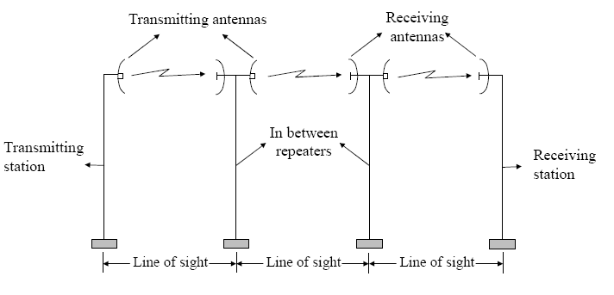
Microwave

Slide 13
Microwave transmission
Microwaves are widely used for point-to-point communications because their small wavelength allows conveniently-sized antennas to direct them in narrow beams, which can be pointed directly at the receiving antenna. This allows nearby microwave equipment to use the same frequencies without interfering with each other, as lower frequency radio waves do.
Another advantage is that the high frequency of microwaves gives the microwave band a very large information-carrying capacity; the microwave band has a bandwidth 30 times that of all the rest of the radio spectrum below it.
A disadvantage is that microwaves are limited to line of sight propagation; they cannot pass around hills or mountains as lower frequency radio waves can.

Slide 14
Satellite communication
A communications satellite or comsat is an artificial satellite sent to space for the purpose of telecommunications. Modern communications satellites use a variety of orbits including geostationary orbits, Molniya orbits, elliptical orbits and low (polar and non-polar) Earth orbits.
For fixed (point-to-point) services, communications satellites provide a microwave radio relay technology complementary to that of communication cables They are also used for mobile applications such as communications to ships, vehicles, planes and hand-held terminals, and for TV and radio broadcasting.

Slide 15
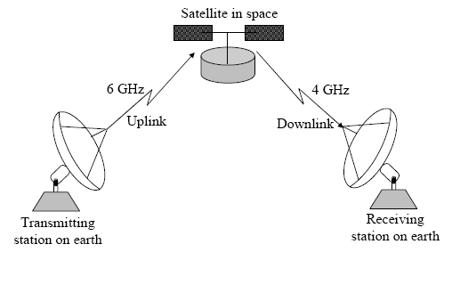
Satellite

Slide 16
Optical Fiber
A technology that uses glass (or plastic) threads (fibers) to transmit data. A fiber optic cable consists of a bundle of glass threads, each of which is capable of transmitting messages modulated onto light waves.
Fiber optics has several advantages over traditional metal communications lines:
Fiber optic cables have a much greater bandwidth than metal cables. This means that they can carry more data. Fiber optic cables are less susceptible than metal cables to interference. Fiber optic cables are much thinner and lighter than metal wires. Data can be transmitted digitally (the natural form for computer data) rather than analogically.
The main disadvantage of fiber optics is that the cables are expensive to install. In addition, they are more fragile than wire and are difficult to splice.

Slide 17
Digital and Analog Data
§ Analog signal: Transmitted power varies over a
continuous range. Example: sound, light, and radio
Waves
§ Digital signal: Sequence of voltage pulses represented
in binary form
§ Computer generated data signal is digital, whereas
telephone lines carry analog signals

Slide 18
Digital and Analog Data
§ Analog signal: Transmitted power varies over a
continuous range. Example: sound, light, and radio
Waves
§ Digital signal: Sequence of voltage pulses represented
in binary form
§ Computer generated data signal is digital, whereas
telephone lines carry analog signals

Slide 19
Digital and Analog Data
§ When digital data is to be sent over an analog facility,
digital signals must be converted to analog form
§ Conversion of digital signal to analog form is known as
Modulation
§ Conversion of analog signal to digital form is known as
Demodulation
§ Digital transmission of data is preferred over analog
transmission of data due to lower cost, higher
transmission speeds, and lower error rate

Slide 20
Digital and Analog Signals

Slide 21
Modulation Techniques
§ Amplitude Modulation (AM): Two binary values (0 and
1) of digital data are represented by two different
amplitudes of the carrier signal, keeping frequency and
phase constant
§ Frequency Modulation (FM): Two binary values of
digital data are represented by two different frequencies,
while amplitude and phase are kept constant
§ Phase Modulation (PM): Two binary values of digital
data are represented by shift in phase of carrier signal

Slide 22
MODEM
§ Modem is short for MOdulator/DEModulator
§ Special device used for conversion of digital data to
analog form (modulation) and vice-versa (demodulation)
§ Essential piece of hardware where two digital devices
(say two computers) want to communicate over an
analog transmission channel (say a telephone line)

Slide 23
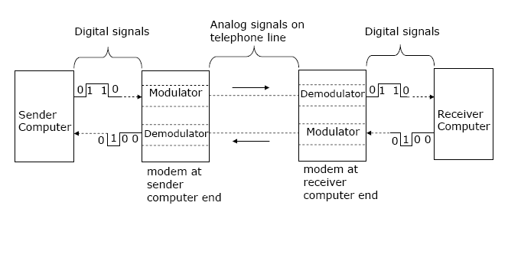
Use of MODEM

Slide 24
MODEM
Factors for MODEM Selection : -
§ Transmission speed
§ Internal versus external
§ Facsimile facility

Slide 25
Transmission Services
Data transmission service providers are popularly
known as common carriers
Various types of services offered by common carriers
are:
§ Dial-up line: Operates in a manner similar to a
telephone line
§ Leased line: Special conditioned telephone line
that directly and permanently connects two
computers
§ Integrated Services Digital Network (ISDN):
Telephone system that provides digital (not analog)
telephone and data services

Slide 26
Transmission Services
Value Added Network (VAN): Provides value-added
data transmission service. Value added over and
above the standard services of common carriers may
include e-mail, data encryption/decryption, access to
commercial databases, and code conversion for
communication between computers

Slide 27
Multiplexing
§ Method of dividing physical channel into many logical
channels so that a number of independent signals may
be simultaneously transmitted
§ Electronic device that performs multiplexing is known
as a multiplexer
§ Multiplexing enables a single transmission medium to
concurrently transmit data between several
transmitters and receivers

Slide 28
Multiplexing
§ Method of dividing physical channel into many logical
channels so that a number of independent signals may
be simultaneously transmitted
§ Electronic device that performs multiplexing is known
as a multiplexer
§ Multiplexing enables a single transmission medium to
concurrently transmit data between several
transmitters and receivers

Slide 29
Types of Multiplexing
§ Frequency-Division Multiplexing (FDM): Available
bandwidth of a physical medium is divided into several
smaller, disjoint logical bandwidths. Each component
bandwidth is used as a separate communication line
§ Time-Division Multiplexing (TDM): Total time
available in a channel is divided among several users,
and each user of the channel is allotted a time slice
during which he/she may transmit a message

Slide 30
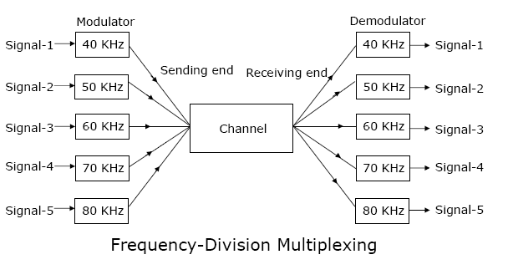
FDM

Slide 31
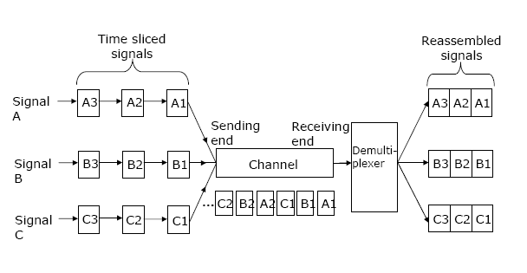
TDM

Slide 32
Transmission Modes
§ Two modes of data transmission on a communication
line are asynchronous and synchronous
Asynchronous transmission
§ Sender can send data at any convenient time and
the receiver will accept it
§ Data is transmitted character by character at
irregular intervals
§ Well suited to many keyboard type terminals

Slide 33
Transmission Modes
Synchronous transmission
§ Sender and receiver must synchronize with each
other to get ready for data transmission before it
takes place
§ Entire blocks of characters are framed and
transmitted together
§ Well suited to remote communication between a
computer and such devices as buffered terminals
and printers

Slide 34
Transmission Modes

Slide 35
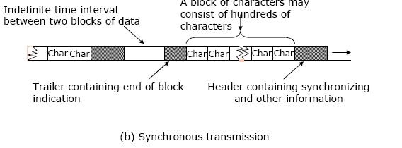
Transmission Modes

Slide 36
Switching Techniques
§ Data is often transmitted from source to destination
through a network of intermediate nodes
§ Switching techniques deal with the methods of
establishing communication links between the sender
and receiver in a communication network
Three commonly used switching techniques are:
§ Circuit switching: Dedicated physical path is
established between sending and receiving stations
through nodes of the network for the duration of
communication

Slide 37
Switching Techniques
§ Message switching: Sender appends receiver’s
destination address to the message and it is
transmitted from source to destination either by
store-and-forward method or broadcast method
§ Packet switching: Message is split up into fixed size
packets and each packet is transmitted independently
from source to destination node. Either store-and forward
or broadcast method is used for transmitting
the packets. All the packets of a message are reassembled
into original message at the destination
node

Slide 38
Circuit Switching

Slide 39
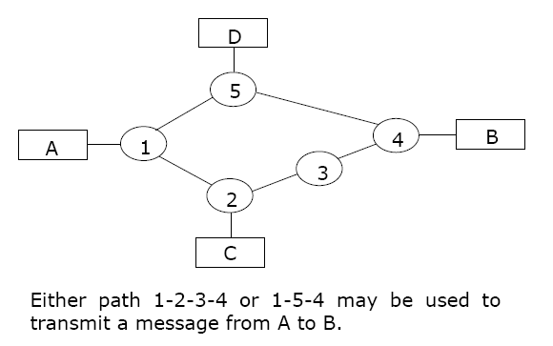
Message Switching
Store and Forward Method

Slide 40
Message Switching
Broadcast Method

Slide 41
Message Switching
§ In a WAN, when multiple paths exist between the source
and destination nodes of a packet, any one of the paths
may be used to transfer the packet
§ Selection of path to be used for transmitting a packet is
determined by the routing technique used
Two popularly used routing algorithms are:
§ Source routing: Source node selects the entire path
before sending the packet
§ Hop-by-hop routing: Each node along the path
decides only the next node for the path

Slide 42
Topologies
§ Term network topology refers to the way in which
the nodes of a network are linked together
§ Although number network topologies are possible,
four major ones are:
§ Star network
§ Ring network
§ Completely connected network
§ Multi-access bus network

Slide 43
Star

Slide 44
Star
A star network features a central connection point called a "hub node" that may be a network hub , switch or router . Devices typically connect to the hub with Unshielded Twisted Pair (UTP) Ethernet. Compared to the bus topology, a star network generally requires more cable, but a failure in any star network cable will only take down one computer's network access and not the entire LAN. (If the hub fails, however, the entire network also fails.)

Slide 45
Ring

Slide 46
Ring
In a ring network, every device has exactly two neighbors for communication purposes. All messages travel through a ring in the same direction (either "clockwise" or "counterclockwise"). A failure in any cable or device breaks the loop and can take down the entire network. To implement a ring network, one typically uses FDDI, SONET or Token Ring technology.

Slide 47
Completely Connected

Slide 48
Completely Connected
Mesh topologies involve the concept of routes. Unlike each of the previous topologies, messages sent on a mesh network can take any of several possible paths from source to destination. (Recall that even in a ring, although two cable paths exist, messages can only travel in one direction.) Some WANs , most notably the Internet, employ mesh routing. A mesh network in which every device connects to every other is called a full mesh. As shown in the illustration below, partial mesh networks also exist in which some devices connect only indirectly to others.

Slide 49
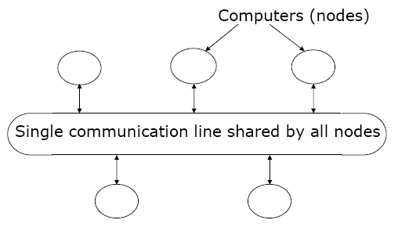
BUS

Slide 50
BUS
Bus networks (not to be confused with the system bus of a computer) use a common backbone to connect all devices. A single cable, the backbone functions as a shared communication medium that devices attach or tap into with an interface connector. A device wanting to communicate with another device on the network sends a broadcast message onto the wire that all other devices see, but only the intended recipient actually accepts and processes the message.

Slide 51
Hybrid

Slide 52
Network Types
Networks are broadly classified into two types: Local
Area Network (LAN) and Wide Area Network (WAN)
§ Local Area Network (LAN) as compared to WAN:
§ Limited to a small geographic coverage
§ Has much higher data transmission rate
§ Experiences fewer data transmission errors
§ Has lower data communication cost
§ Typically owned by a single organization
§ Networks that share some of the characteristics of both
LANs and WANs are referred to as Metropolitan Area
Network (MAN)

Slide 53
Communication Protocols
Protocol is a set of formal operating rules, procedures,
or conventions that govern a given process
Communication protocol describes rules that govern
transmission of data over communication networks
§ Roles of communication protocol:
§ Data sequencing
§ Data routing
§ Data formatting
§ Flow control
§ Error control

Slide 54
Communication Protocols
§ Precedence and order of transmission
§ Connection establishment and termination
§ Data security
§ Log information.
§ Communication protocols are normally split up into a
series of modules logically composed of a succession of
layers.
§ Terms protocol suite, protocol family, or protocol stack
are used to refer to the collection of protocols (of all
layers) of a network system

Slide 55
OSI Model
§ The Open System Interconnection (OSI) model is
framework for defining standards for linking
heterogeneous computers in a packet switched
Network
§ Standardized OSI protocol makes it possible for any
two heterogeneous computer systems, located
anywhere in the world, to easily communicate with
each other
§ Separate set of protocols is defined for each layer in its
seven-layer architecture. Each layer has an
independent function

Slide 56
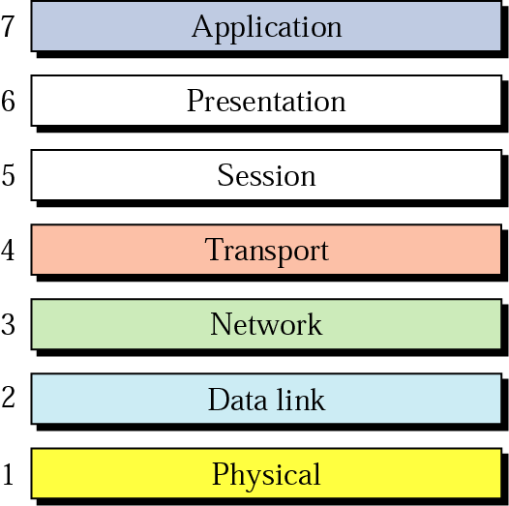
OSI Model

Slide 57
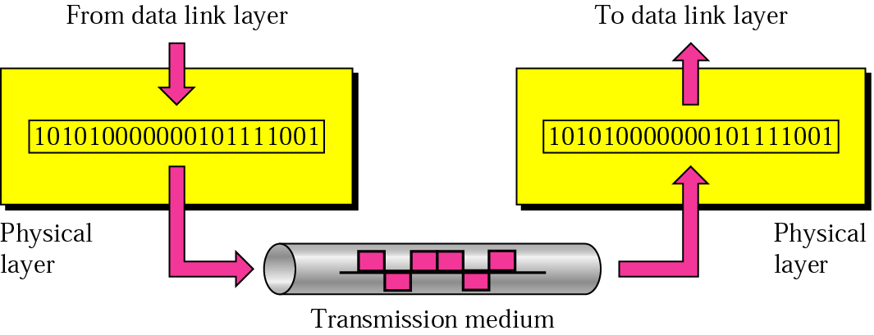
Physical Layer
The physical layer is responsible for transmitting individual bits from one node to the next.

Slide 58
Physical Layer
Responsibilities of Physical Layer :-
Deals with Physical Characteristics of medium.
Representation of bits (how to represent 0 and 1 by volts)
Design issue mainly deals with mechanical, electrical and timing interfaces.
Synchronization of bits
Transmission technique (baseband or broadband)
Physical topology
Transmission mode

Slide 59
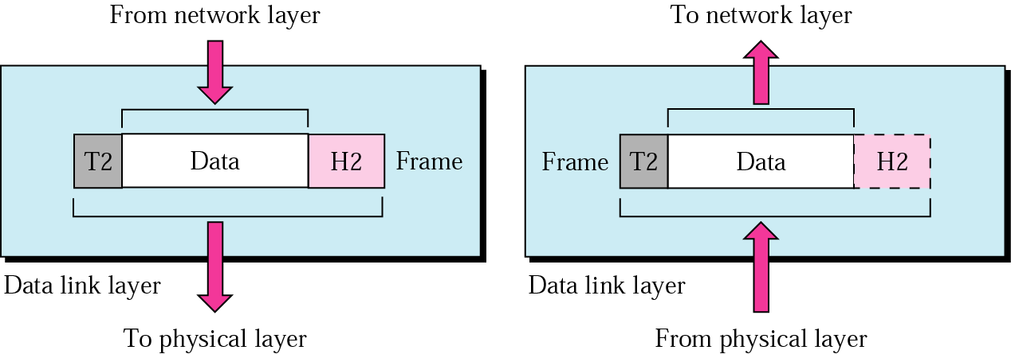
Data Link Layer
The data link layer is responsible for transmitting frames from one node to the next.

Slide 60
Data Link Layer
Responsibilities of Data Link Layer :-
Framing – it breaks down the data into data frames and transfer them sequentially. Frames consist of character count, flag bytes, physical addresses, error codes etc.
Link establishment and termination.
Flow Control – Regulating flow of control so that slow receivers are nor swamped by fast senders. Acknowledgment frames are used for this purpose.
Error Control- uses error detection and error coorection codes to deal with errors that creep between data.
Access Control- how to control access over shared channel.
This is done by a sub layer called MAC (Medium Access Control).

Slide 61
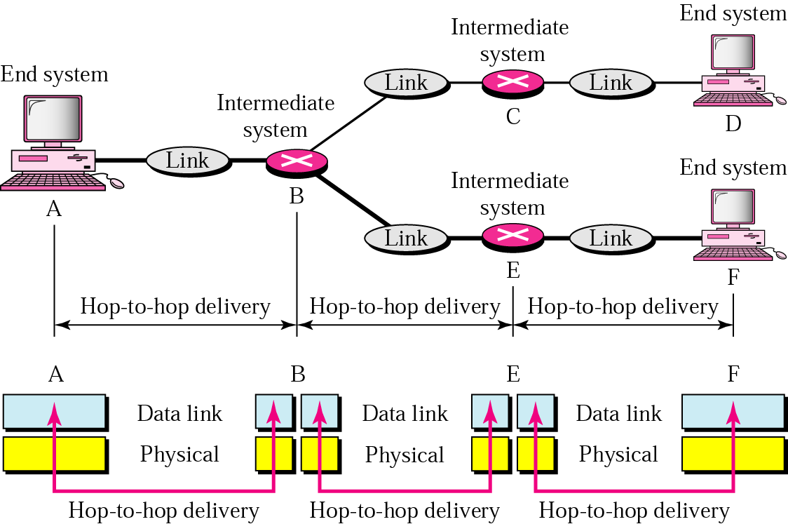
Node to Node Delivery

Slide 62
Node to Node Delivery
Example
In Figure (next slide), a node with physical address 10 sends a frame to a node with physical address 87. The two nodes are connected by a link. At the data link level this frame contains physical addresses in the header. These are the only addresses needed. The rest of the header contains other information needed at this level. The trailer usually contains extra bits needed for error detection

Slide 63
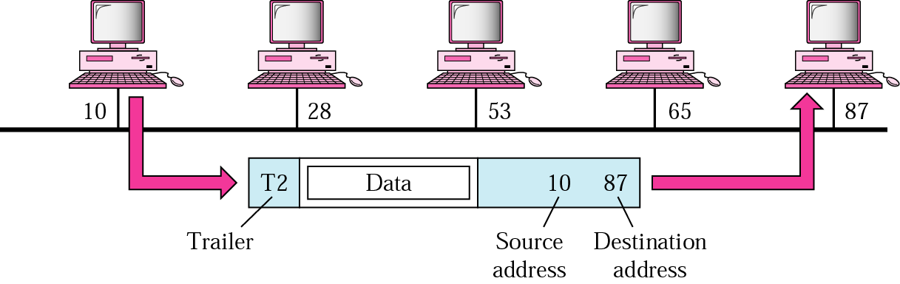
Node to Node Delivery
Example

Slide 64
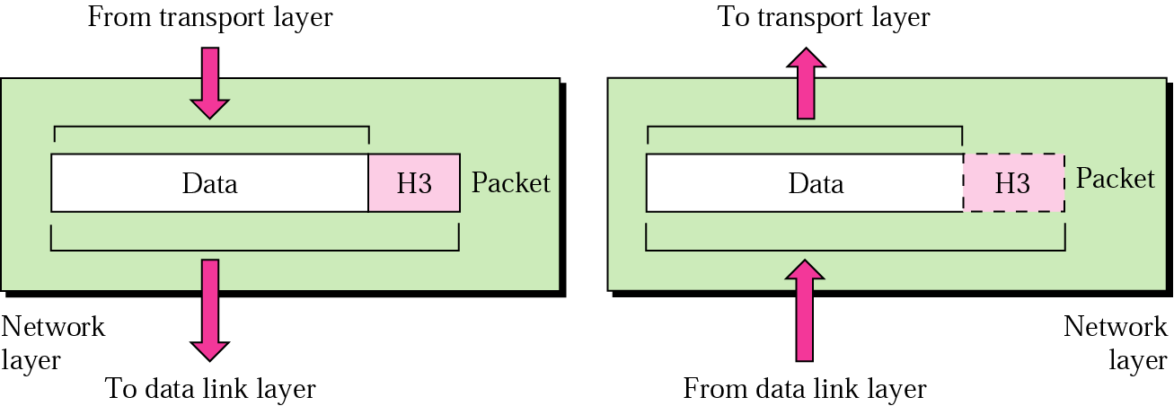
Network Layer
The network layer is responsible for the delivery of packets from the original source to the final destination.

Slide 65
Network Layer
Responsibilities of Network Layer :-
Logical Addressing
Implementation of connectionless and connection oriented services. Done by means of datagram subnets and virtual circuit subnet.
Routing (static or dynamic)
Routing algos may be adaptive or non adaptive. Non adaptive algos do not change their routing decisions on the basis of current traffic and topology. Instead they select the route in advance, off-line.
Some examples of routing algos are:
Flooding Shortest Path
Broadcasting Link State
Multicasting Distance Vector
Hierarchical

Slide 66
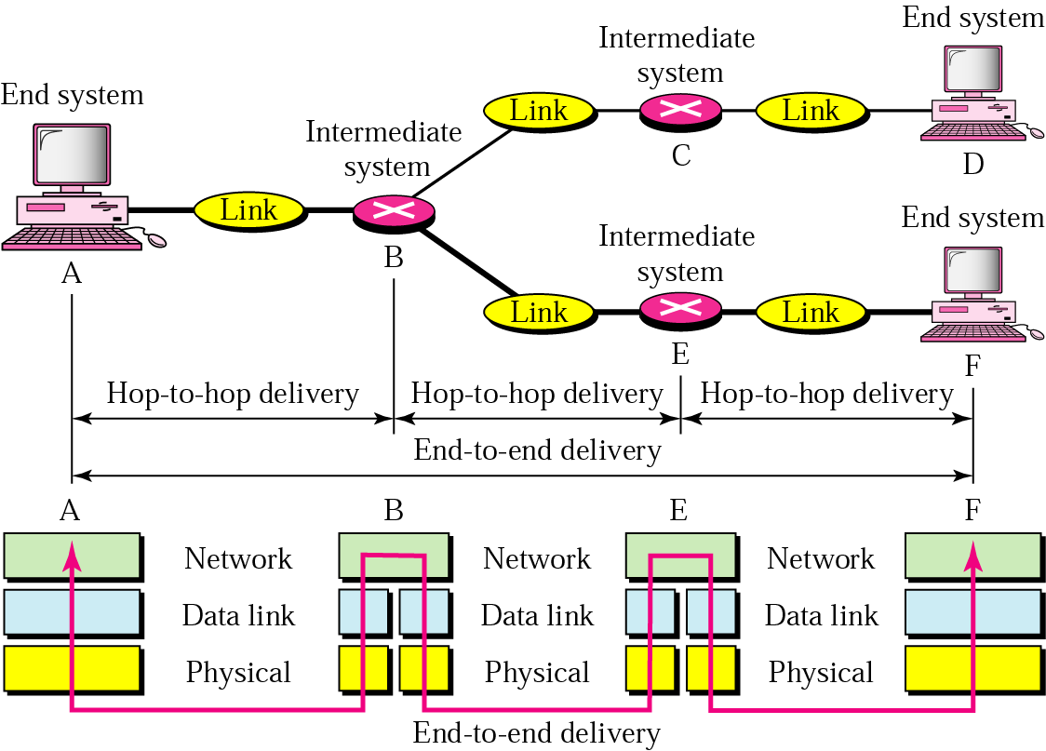
Source – to - Destination

Slide 67
Source – to - Destination
Example
In Figure, we want to send data from a node with network address A and physical address 10, located on one LAN, to a node with a network address P and physical address 95, located on another LAN. Because the two devices are located on different networks, we cannot use physical addresses only; the physical addresses only have local jurisdiction. What we need here are universal addresses that can pass through the LAN boundaries. The network (logical) addresses have this characteristic.

Slide 68
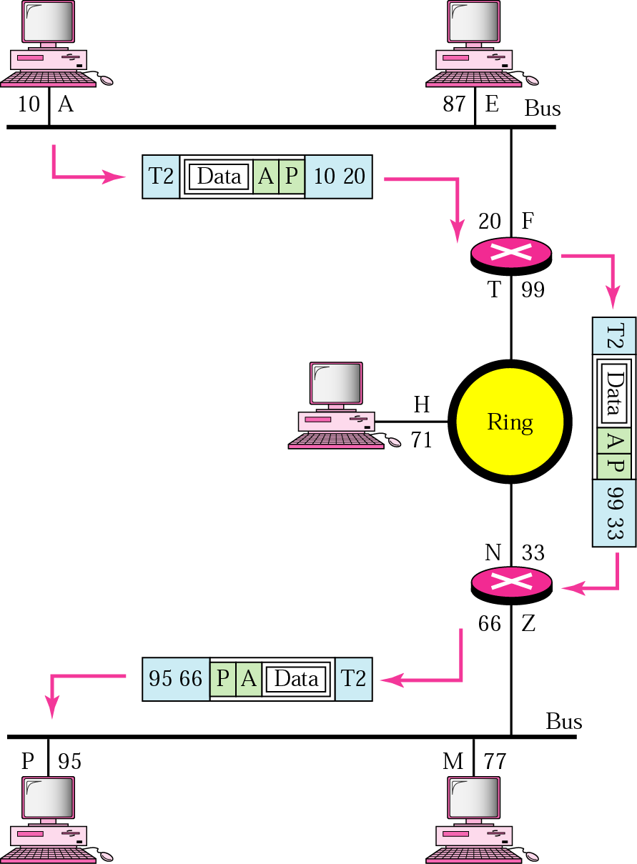
Source – to - Destination
Example

Slide 69
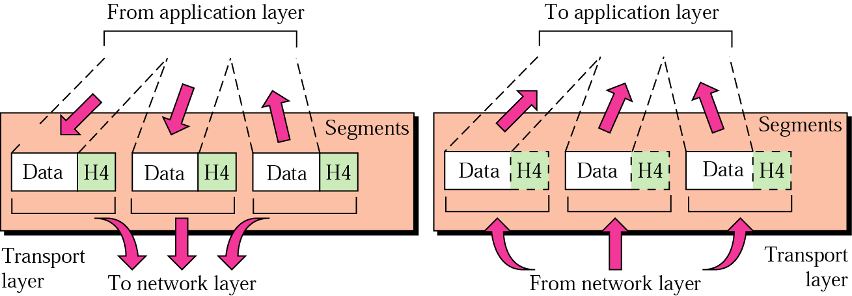
Transport Layer
The transport layer is responsible for delivery of a message from one process to another.

Slide 70
Transport Layer
Its task is to provide relaible, cost-effective data transport from the source machine to destination machine, independently of the physical network or network I use.
Responsibilities of Transport Layer :-
Provides host to host, end-to-end communication services for applications.
Segmentation and reassembly
Connection control
Flow control
Error Control
Congestion avoidance

Slide 71
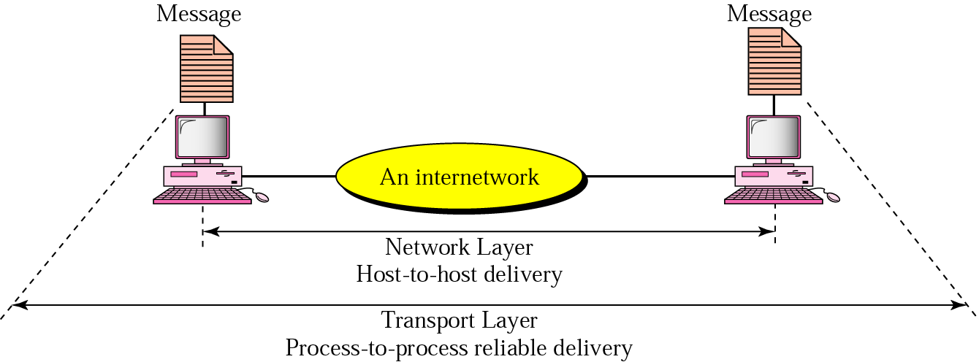
Process to Process

Slide 72
Session Layer
The session layer is responsible for dialog control and synchronization.

Slide 73
Presentation Layer
The presentation layer is responsible for translation, compression, and encryption.

Slide 74
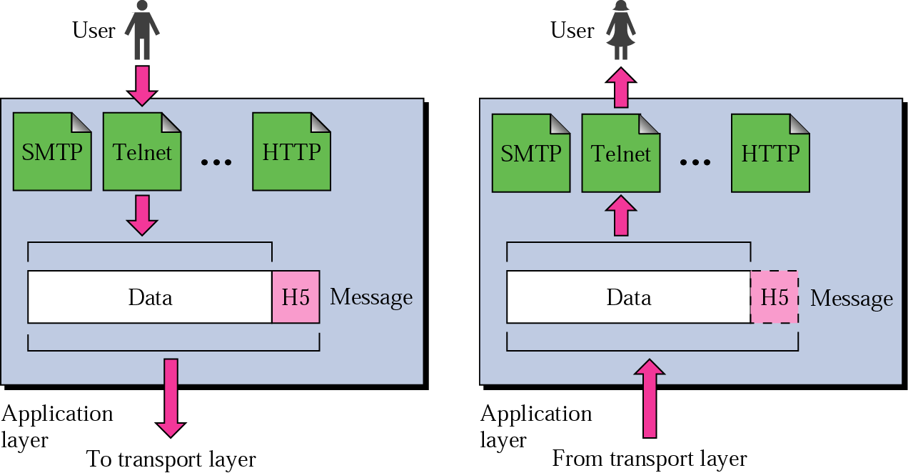
Application Layer
The application layer is responsible for providing services to the user.

Slide 75
Application Layer
Services provided by the Application Layer :-
Remote File transfer, access and management
Network Messages , Mail services
Directory services
Resource Sharing.

Slide 76
Summary of OSI Model
Physical layer | Deals with the mechanical and electrical specification of the interface and transmission media.
Data Link Layer | Transforms the physical layer, to a reliable link and is responsible for node-to-node delivery.
Network Layer | Responsible for the source-to-destination delivery of a packet across multiple links.

Slide 77
Summary of OSI Model
Transport Layer | Responsible for the source-to-destination (end-to-end) delivery of the entire message.
Session Layer | It establishes, maintains and synchronizes the interaction between communicating systems.
Presentation Layer | It concerns with the syntax and semantics of the information between two systems.

Slide 78
Summary of OSI Model
Application Layer | It provides user interfaces and support for services such as E-Mail, Remote Login and other types of Distributed Information Services.

Slide 79
OSI Model

Slide 80
Internetworking Devices
§ Interconnecting two or more networks to form a single
network is called internetworking, and the resulting
network is called an internetwork.
§ Goal of internetworking is to hide details of different
physical networks, so that resulting internetwork
functions as a single coordinated unit.
§ Tools such as bridges, routers, brouters, and gateways
are used for internetworking.
§ The Internet is the best example of an internetwork.

Slide 81
Hubs
Hubs are used to build a LAN by connecting different computers in a star/hierarchal network topology, the most common type on LANs now a day. A hub is a very simple (or dumb) device, once it gets bits of data sent from computer A to B, it does not check the destination, instead, it forwards that signal to all other computers (B, C, D…) within the network. B will then pick it up while other nodes discard it. This implies that the traffic is shared.
There are mainly two types of hubs:
1. Passive: The signal is forwarded as it is (so it doesn’t need power supply). 2. Active: The signal is amplified, so they work as repeaters. In fact they have been called multiport repeaters. (use power supply)
Hubs can be connected to other hubs using an uplink port to extend the network.
Hubs work on the physical layer (lowest layer). That’s the reason they can’t deal with addressing or data filtering.

Slide 82
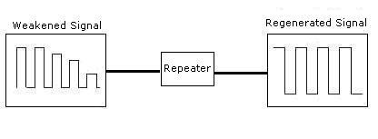
Repeaters
As signals travel along a network cable (or any other medium of transmission), they degrade and become distorted in a process that is called attenuation. If a cable is long enough, the attenuation will finally make a signal unrecognizable by the receiver.
A Repeater enables signals to travel longer distances over a network. Repeaters work at the OSI's Physical layer. A repeater regenerates the received signals and then retransmits the regenerated (or conditioned) signals on other segments.

Slide 83
Switches
Switches on the other hand are more advanced. Instead of broadcasting the frames everywhere, a switch actually checks for the destination MAC address and forward it to the relevant port to reach that computer only. It also protects frames from being sniffed by other computers sharing the same segment.
They build a table of which MAC address belongs to which segment. If a destination MAC address is not in the table it forwards to all segments except the source segment. If the destination is same as the source, frame is discarded.

Slide 84
Bridges
Bridges are normally used to connect LAN segments within a limited geographic area (local bridges), like a building or a campus. It operates at the data link layer. It examines all frames and it recognizes where they came from, and where they are going to. It selectively (frame filtering) transfers frames from any port to other ports. It does not propagate noise signals and defective frames. It reduces traffic on each port and it improves security since each port will only transmit frames directed to nodes reachable from that port.
Bridges can be used to:
Expand the distance of a segment.
Provide for an increased number of computers on the network.
Reduce traffic bottlenecks resulting from an excessive number of attached computers.

Slide 85
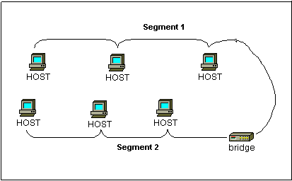

Slide 86
Routers
A router is used to route data packets between two networks. It reads the information in each packet to tell where it is going. They can connect networks with different architectures such as Token Ring and Ethernet. Although they can transform information at the data link level.
If the routing table does not indicate the proper address of a packet, the packet is discarded.
Routers can share status and routing information with one another and use this information to bypass slow or malfunctioning connections. outers do not look at the destination node address; they only look at the network address.
Routers will only pass the information if the network address is known. This ability to control the data passing through the router reduces the amount of traffic between networks and allows routers to use these links more efficiently than bridge

Slide 87
Gateways
Gateways are very intelligent devices or else can be a computer running the appropriate software to connect and translate data between networks with different protocols or architecture, so their work is much more complex than a normal router.
Gateways make communication possible between different architectures and environments. They repackage and convert data going from one environment to another so that each environment can understand the other's environment data.
A gateway repackages information to match the requirements of the destination system. Gateways can change the format of a message so that it will conform to the application program at the receiving end of the transfer.
A gateway links two systems that do not use the same:
Communication protocols
Data formatting structures
Languages
Architecture

Slide 88
Wireless Communication
§ Wireless computing system uses wireless communication
technologies for interconnecting computer systems
§ Enhances functionality of computing equipment by freeing
communication from location constraints of wired
computing systems
§ Wireless computing systems are of two types:
§ Fixed wireless systems: Support little or no
mobility of the computing equipment associated with
the wireless network
§ Mobile wireless systems: Support mobility of the
computing equipment to access resources associated
with the wireless network

Slide 89
Wireless Technology
§ 2G and 3G
§ Wireless LAN
§ WiMAX
§ Wireless Local Loop (WLL)
§ Radio-router
§ Multihop Wireless Network
§ Wireless Application Protocol (WAP)

Slide 90
Distributed Computing
§ Configuration where many independent computer
systems are connected, and messages, processing task,
programs, data, and other resources are transmitted
between cooperating computer systems
§ Such an arrangement enables sharing of many
hardware and software resources as well as information
among several users who may be sitting far away from
each other

Slide 91
Distributed Computing
§ Inherently distributed applications
§ Information sharing among distributed users
§ Resource sharing
§ Shorter response times and higher throughput
§ Higher reliability
§ Extensibility and incremental growth
§ Better flexibility in meeting users’ needs

Slide 92
Conclusion

Slide 93
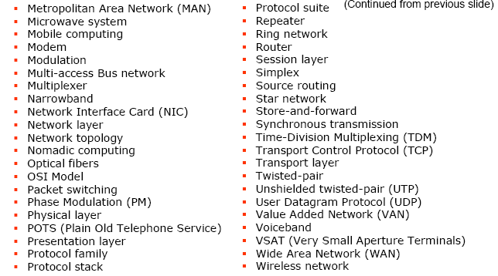
Conclusion

Slide 94
Objective Type Questions
What is ISDN ?
NIC stands for __________.
What do you mean by LAN ?
What is a repeater ?
What is Multiplexing ?
What do you mean by Bitrate and Baudrate ?
What do you mean by Hop-by-Hop routing?
What is Source routing ?
What is half-Duplex transmission modes ?
Difference between Synchronous and Asynchronous Communication.

Slide 95
Short Type Questions
What is Value Added Network?
List some applications that can benefit from wireless computing systems.
Why is layering used in design of communication networks ?
What is packet switching ?
What is routing ?
What is a multiplexer ?
What do you understand by Modulation and Demodulation ?

Slide 96
Short Type Questions
8. Write a short note on router ?
9. What is a Computer Network ?
10. Explain the terms – “bandwidth” and “baud” ?

Slide 97
Long Type Questions
What are internetworking devices ?
Explain transmission media ?
Difference between Analog and Digital transmission of data. Write their advantages and disadvantages.
Write a short note on different types of Data Transmission Services.
Explain Store-and-forward method of message switching. What are its advantages and disadvantages.
What is a communication protocol ? What normal functions are performed by these protocols.
What is Distributed Computing system ?

Slide 98
Long Type Questions
8. Differentiate among LAN, MAN & WAN with examples.
9. What is network? Explain the tradeoffs of various topologies of network.
10. Discuss the features of different layers of the OSI reference model with complete diagram. How it is different from TCP-IP model?
11. Explain the types of Switching techniques along with illustrative diagrams. What are their advantages and limitations?
12. Differentiate among Narrowband, Voice band and Broad communication channels. Give a practical application of each.

Slide 99
References
Main Reading Books:
1. P. K. Sinha and Priti Sinha , “Computer Fundamentals”, BPB Publications, 2007.
2. Alex Leon and Mathews Leon, “Fundamentals of Information Technology”, Leon Techworld, 2007.
3. V. Rajaraman, “Introduction to Information Technology”, PHI, 2006.
REFERENCES:
1. Alex Leon and Mathews Leon, “Introduction to Computers”, Vikas Publishing House,2007.
2. Norton Peter, “Introduction to computers”, TMH, 4th Ed., 2006.
3. Simon Haykins, “Communication System”, John Wiley & Sons, 2006.
4. B. Basaraj, “Digital Fundamentals”, Vikas Publications, 1999.
5. V. Rajaraman, “Fundamentals of Computers”, PHI, 5th Ed., 2006.
6. David Anfinson and Ken Quamme, “IT Essentials PC Hardware and Software Component on Guide”, Pearson, 3rd Ed., 2008.
7. Malvino and Leach, “Digital Principles and Application”, TMH, 1999.
8. Ramesh S. Gaonkar, "Microprocessor Architecture Programming and Application with 8085”, PHI, 2001.

